Slide 1
Graphs
Computer Science, Purdue University
Copyright Wiley, Goodrich and Tamassia

Slide 2
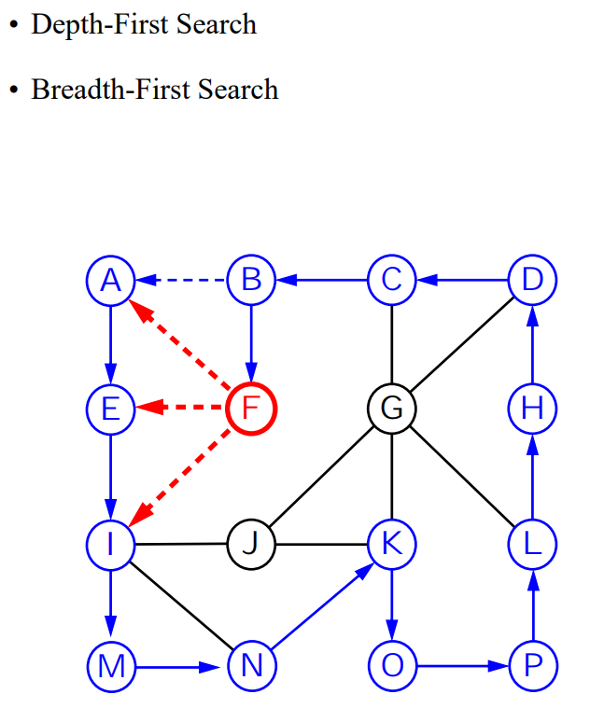
Graphs
Traversals
Computer Science, Purdue University

Slide 3
Graphs
Traversals
Computer Science, Purdue University

Slide 4
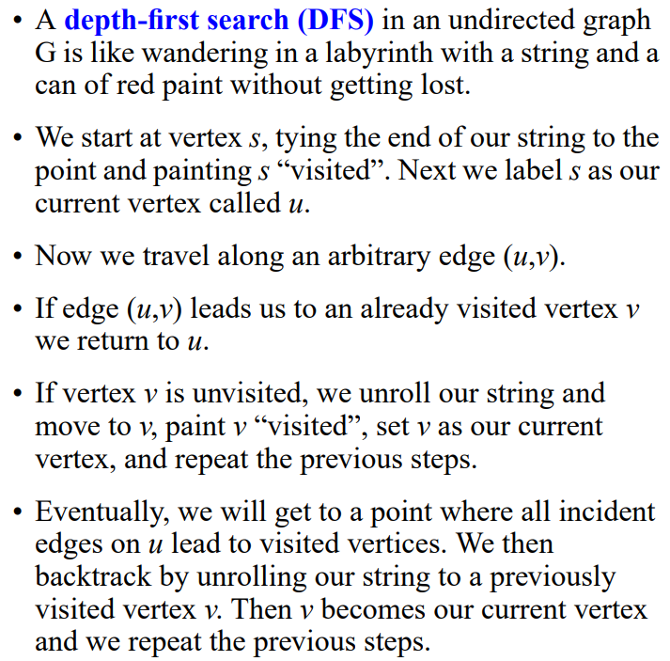
Graphs
Depth-First Search
Computer Science, Purdue University

Slide 5
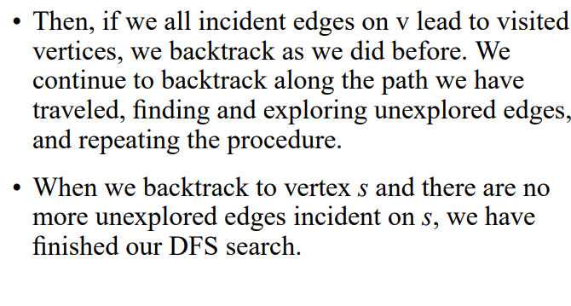
Graphs
Depth-First Search
Computer Science, Purdue University

Slide 6
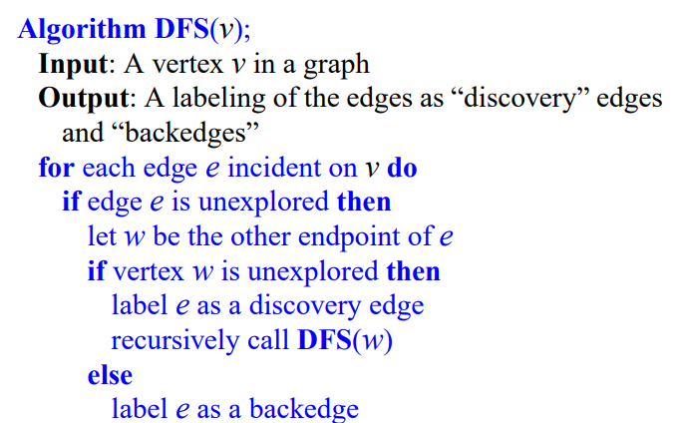
Graphs
Depth-First Search
Computer Science, Purdue University

Slide 7
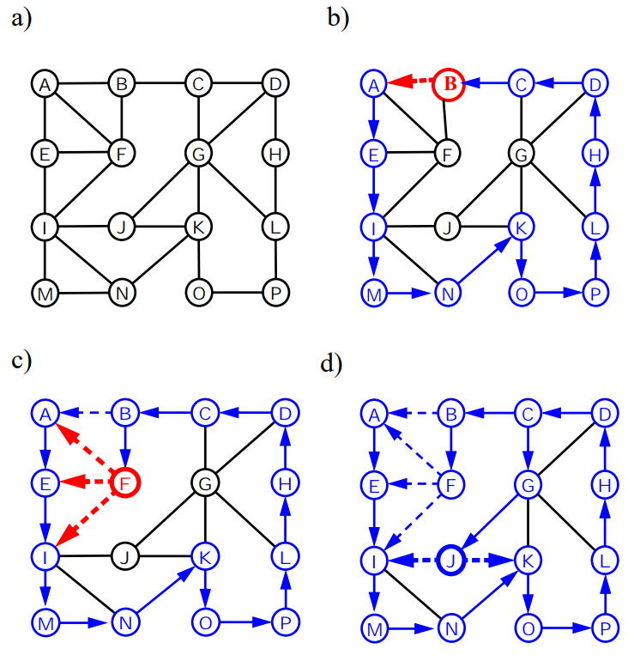
Graphs
Depth-First Search
Computer Science, Purdue University

Slide 8
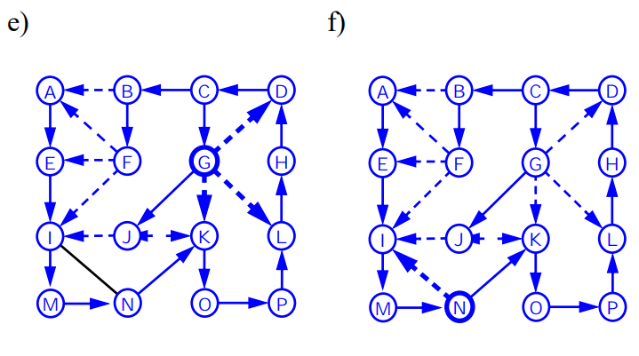
Graphs
Depth-First Search
Computer Science, Purdue University

Slide 9
Graphs
Depth-First Search Properties
Let G be an undirected graph on which a DFS traversal starting at a vertex s has been preformed. Then:
The traversal visits all vertices in the connected component of s
The discovery edges form a spanning tree of the connected component of s
Justification of 1): - Let’s use a contradiction argument: suppose there is at least on vertex v not visited and let w be the first unvisited vertex on some path from s to v.
- Because w was the first unvisited vertex on the path, there is a neighbor u that has been visited.
- But when we visited u we must have looked at edge(u, w). Therefore w must have been visited.
Justification of 2):
We only mark edges from when we go to unvisited vertices. So we never form a cycle of discovery edges, i.e. discovery edges form a tree.
This is a spanning tree because DFS visits each vertex in the connected component of s
Computer Science, Purdue University

Slide 10
Graphs
Depth-First Search Runtime
Remember:
DFS is called on each vertex exactly once.
For every edge is examined exactly twice, once from each of its vertices
For n_{s} vertices and m_{s} edges in the connected component of the vertex s, a DFS starting at s runs in O(n_{s} +m_{s}) time if:
The graph is represented in a data structure, like the adjacency list, where vertex and edge methods take constant time
Marking the vertex as explored and testing to see if a vertex has been explored takes O(1)
We have a way of systematically considering the edges incident on the current vertex so we do not examine the same edge twice.
Computer Science, Purdue University

Slide 11
Graphs
Depth-First Search: Marking Vertices
Let’s look at ways to mark vertices in a way that satisfies the above condition.
Extend vertex positions to store a variable for marking
Use a hash table mechanism which satisfies the above condition in the probabilistic sense, because it supports the mark and test operations in O(1) expected time
Computer Science, Purdue University

Slide 12
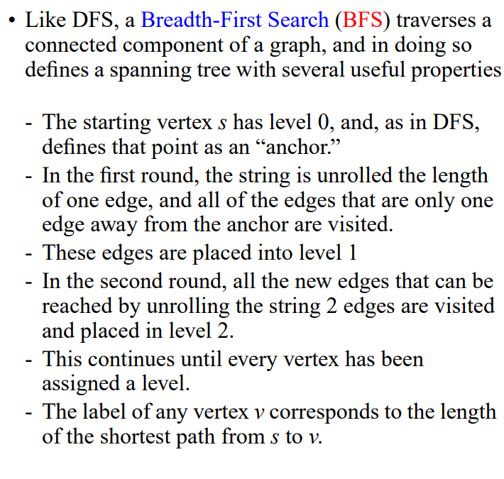
Graphs
Breadth-First Search
Computer Science, Purdue University

Slide 13
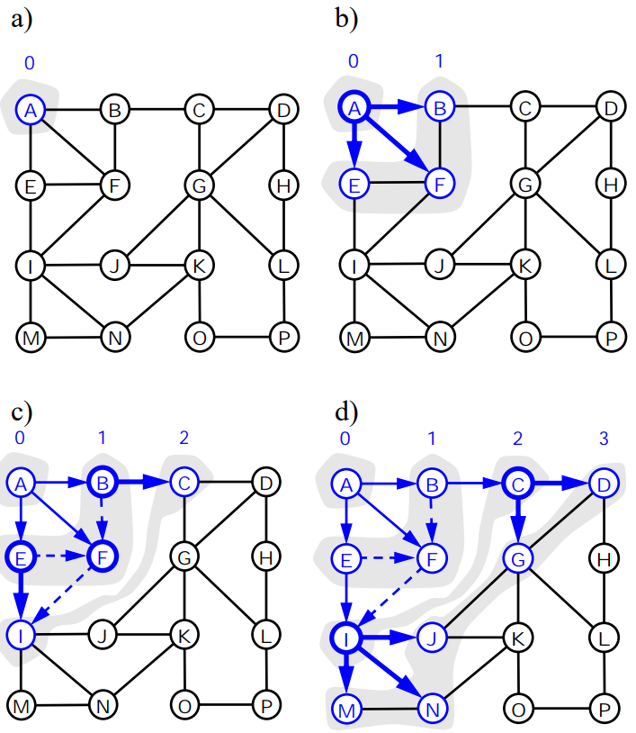
Graphs
Breadth-First Search
Computer Science, Purdue University

Slide 14
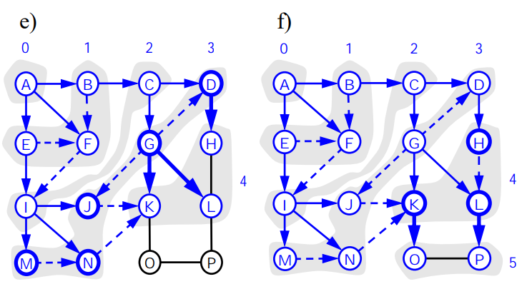
Graphs
Breadth-First Search
Computer Science, Purdue University

Slide 15
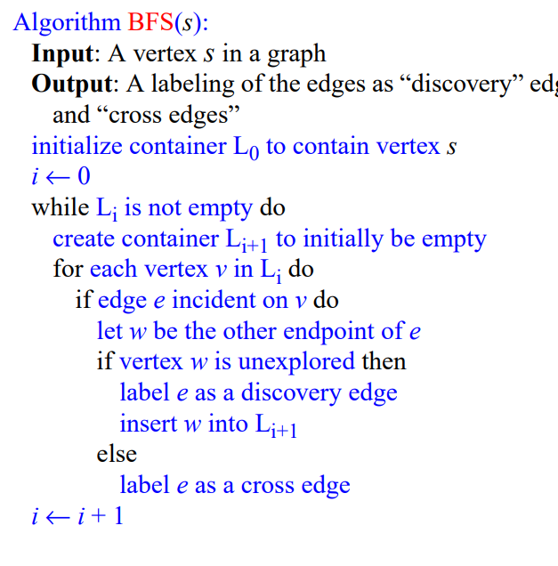
Graphs
Breadth-First Search
Computer Science, Purdue University

Slide 16
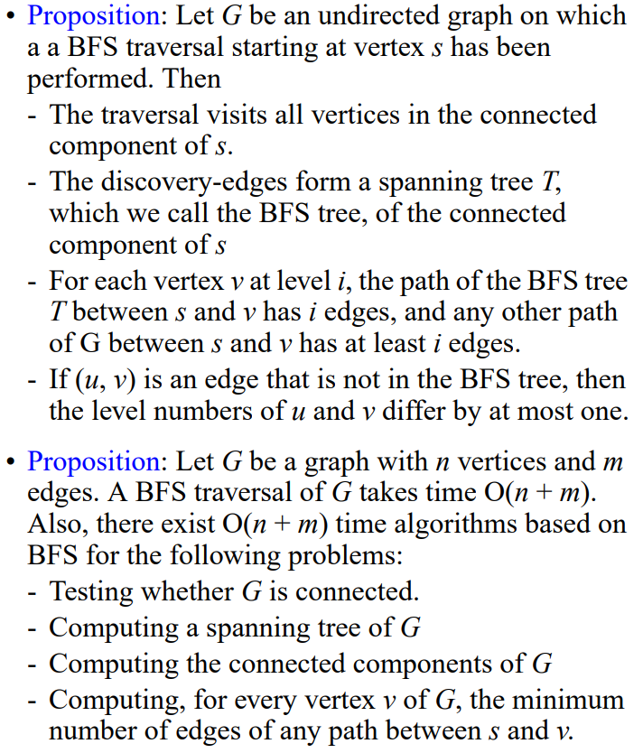
Graphs
Breadth-First Search
(Properties)
Computer Science, Purdue University

Slide 17
Thank You

